Slide 1
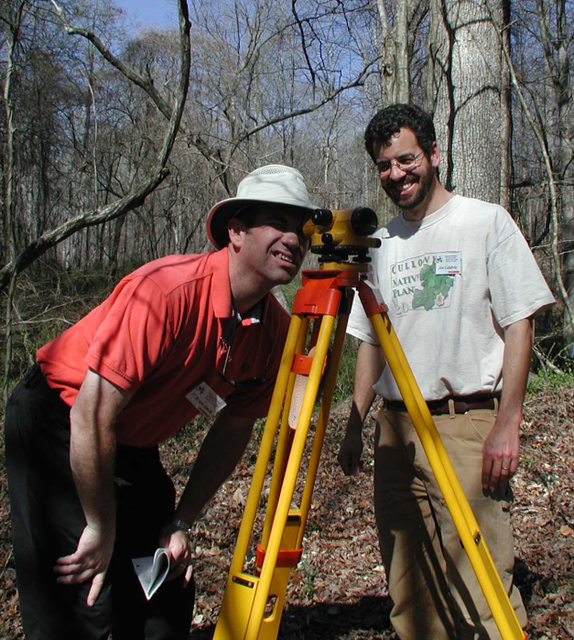
Engineer
a person trained and skilled in the design, construction, and use of engines or machines, or in any of various branches of engineering

Slide 2
Civil Engineering

Slide 3
Definition
The design and construction of public structures
Most civil engineering today deals with power plants, bridges, roads, railways, structures, water supply, irrigation, environment, sewer, flood control and traffic.

Slide 4
History
The first self-proclaimed civil engineer was John Smeaton (1724- 1792).
In 1818 the Institution of Civil Engineers was founded in London and received a Royal Charter in 1828, formally recognizing civil engineering as a profession.
The first degrees in Civil Engineering in the United States was awarded to William Clement, Jacob Eddy, Edward Suffern and Amos Westcott by Rensselaer Polytechnic Institute in 1835.
The first such degree to be awarded to a woman was granted by Cornell University to Nora Stanton Blatch in 1905.

Slide 5
Civil Engineering: Technical Specialties
Construction Engineering
Environmental Engineering
Geotechnical Engineering
Structural Engineering
Transportation Engineering
Urban Planning
Water Resources

Slide 6
Structural Engineering
As a structural engineer, you will face the challenge of analyzing and designing structures to ensure that they safely perform their purpose.
They must support their own weight and resist dynamic environmental loads such as hurricanes, earthquakes, blizzards, and floods.

Slide 7
VIDEO TIME

Slide 8
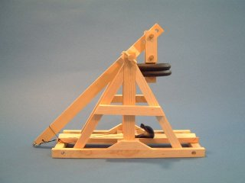
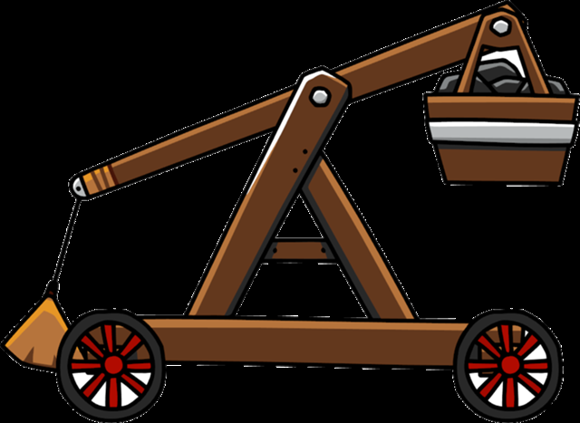
Trebuchet
A medieval engine of war with a sling for hurling missiles.
Fixed counterweight
Swinging counterweight

Slide 9
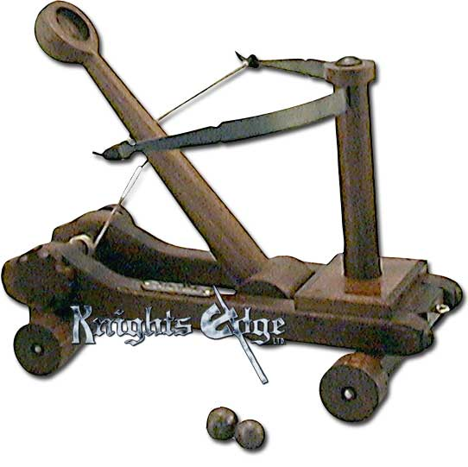
Catapult
an ancient military engine for hurling stones, arrows, etc.

Slide 10
Counterweight
a weight used as a counterbalance.

Slide 11
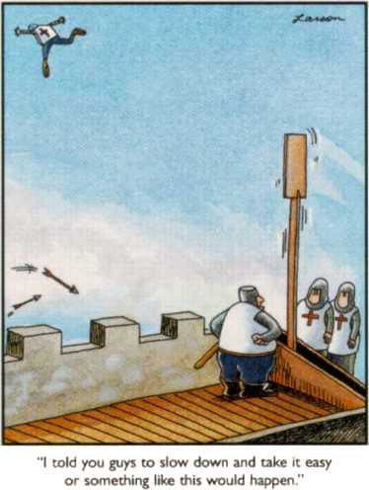
Projectile
a body projected or impelled forward, as through the air.
Bullets, rocks, balls, water.

Slide 12
Trajectory
the curve described by a projectile, rocket, or the like in its flight.

Slide 13
VIDEO TIME

Slide 14
Material costs

Slide 15
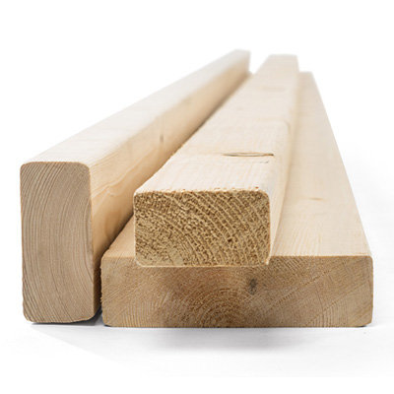
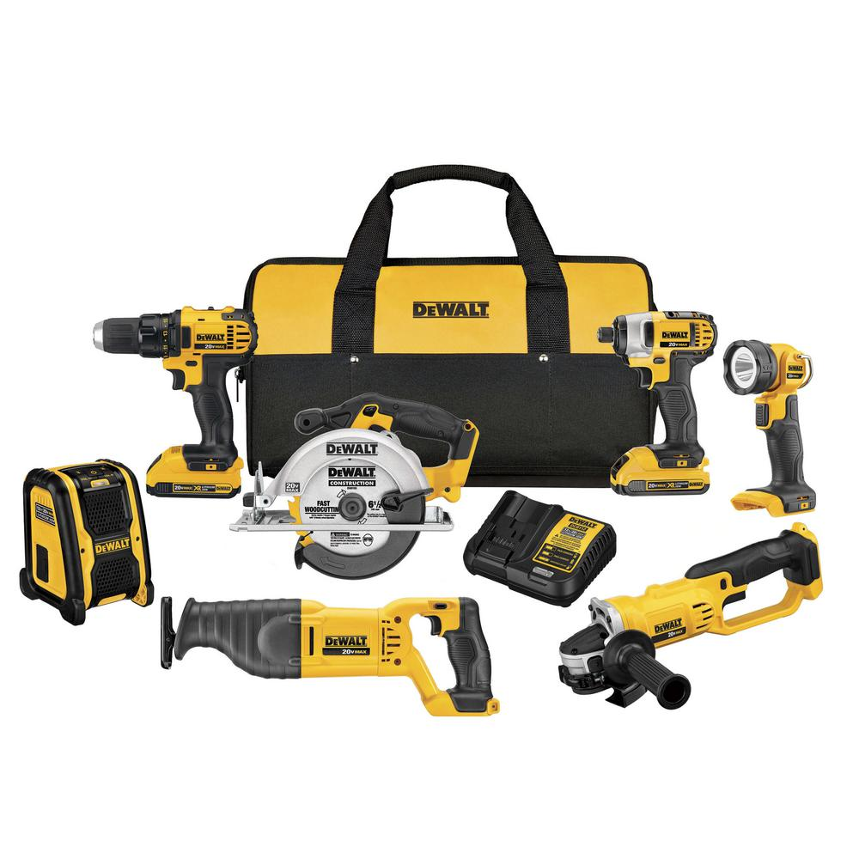
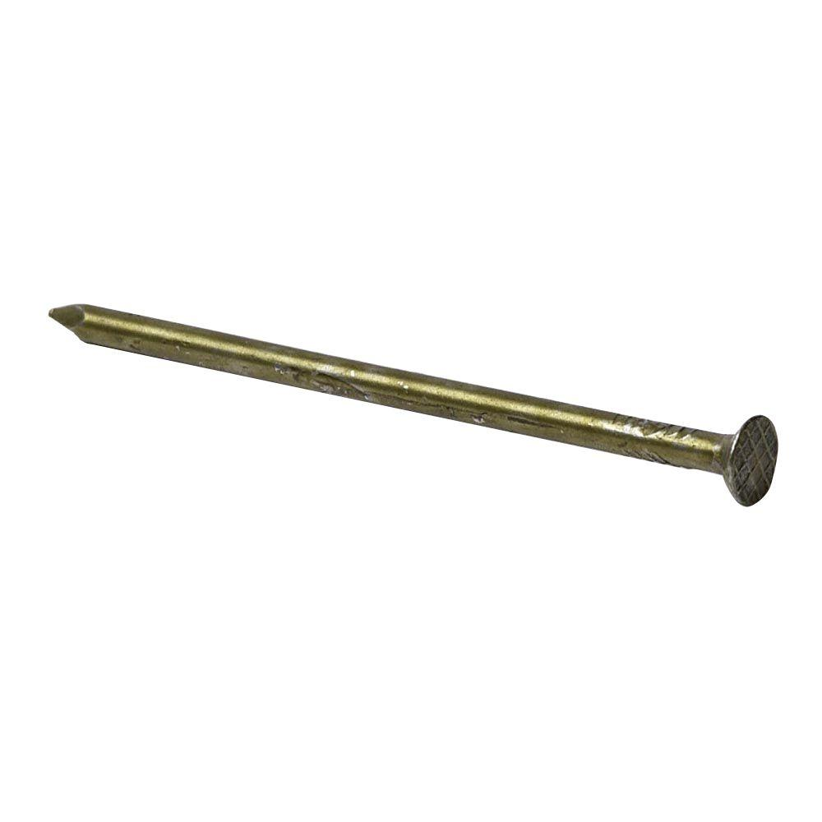
Wood
2”x4”x8’
$3.43 each
2”x4”x12’
$5.62 each
Nails
$2.98 per pound
Tools
$450

Slide 16
MATH TIME
Work out this problem:
If you were framing a small shed with the following dimensions, how much would the materials cost outside of the cost of the tools?
12’ x 12’ square frame with a triangular roof that uses 8’ boards attached to each of the four walls to make the triangular shape
Each board must be 12” from the next board on each wall and each side of the roof. Count only two sides for the roof.
All board are 2”x4”

