Slide 1
Bridges

Slide 2
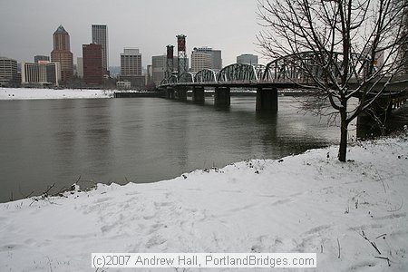
Force-stress or strain on a structure
Compression
tension
torsion
shear
bending
Natural Force
Winds
Tornado
Hurricane
Weather
Rain
Fog
Heat
Ships/boats
Earthquakes
Fire
Load-weight the bridge must hold up

Slide 3
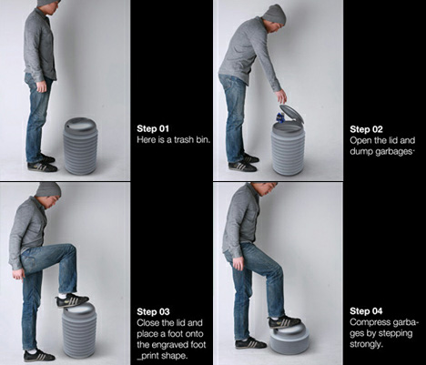
Common Forces
Compression-a force that squeezes a material apart. When a material is in compression, it tends to become shorter.

Slide 4
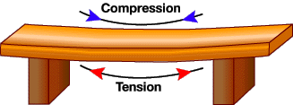
Common Forces
Tension-a force that stretches a material apart. When a material is in tension, it tends to become longer.

Slide 5
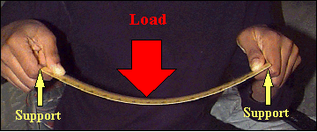
Common Forces
Bending-Bending occurs when a straight material becomes curved, causing one side to squeeze together and the other side to stretch apart.

Slide 6
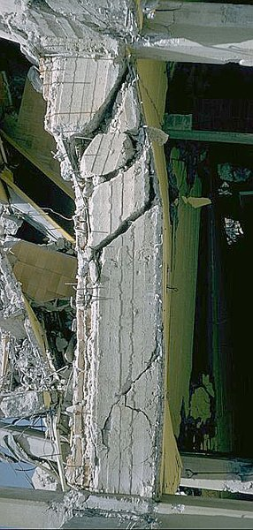
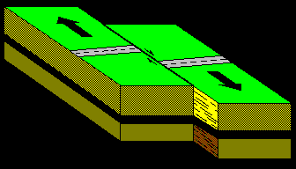
Common Bridge Terms
Shear-A force that causes parts of a material to slide past one another in opposite directions.

Slide 7
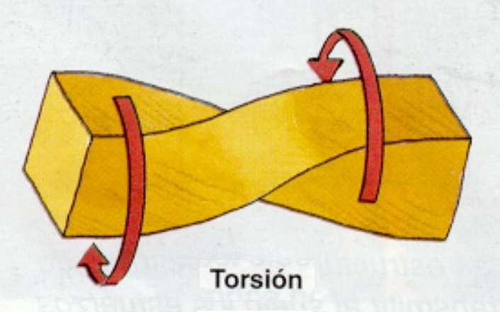
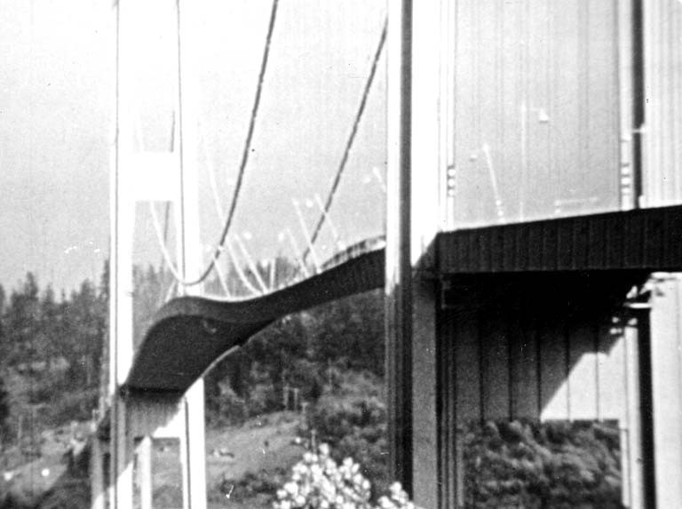
Common forces
Torsion-A force that twists a material. Torsion of a structure is often caused by strong winds.

Slide 8
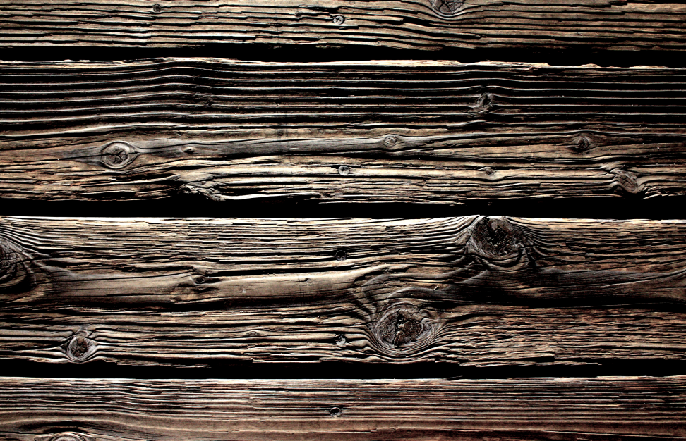
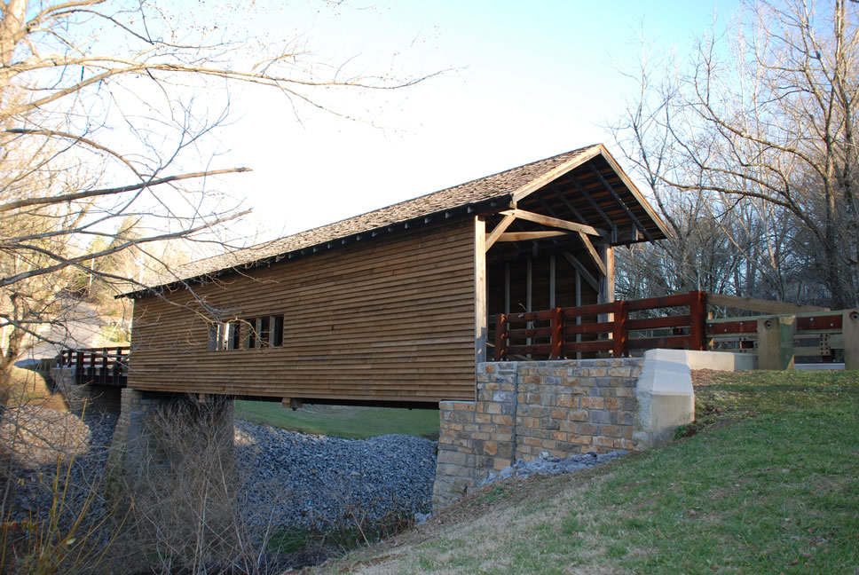
Properties of Materials
Wood-the hard fibrous substance found in trees.
Advantages: Cheap, lightweight, and moderately strong in compression and tension.
Disadvantages: Rots, swells, and burns easily

Slide 9
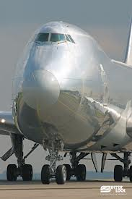
Properties of Materials
Aluminum-light weight, silvery metal
Advantages: Lightweight, doesn’t rust, strong in compression and tension. Can be molded in any shape.
Disadvantages: Expensive

Slide 10
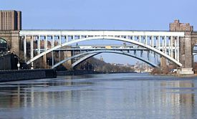
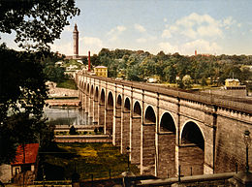
Brick-building block of baked clay usually in a rectangular shape.
Stone-natural rock that is shaped.
Advantages: Cheap, strong in compression.
Disadvantages: Heavy, weak in tension.
High Bridge in New York 1837

Slide 11
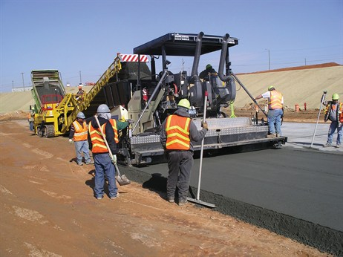
Properties of Materials
Concrete-building material of cement and hard matter like rocks or sand.
Advantages: Cheap, fireproof, weatherproof, molds to any shape, strong in compression.
Disadvantages: Cracks with temperature changes, weak in tension.

Slide 12
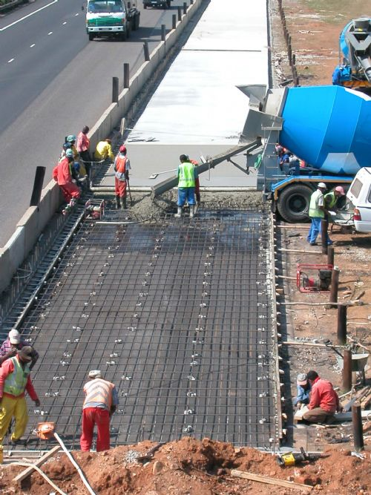
Reinforced concrete-concrete containing steel bars, strands, mesh, to absorb tension and sheering stresses.
Advantages: Cheap, fireproof, weatherproof, molds to any shape, strong in compression and tension.
Disadvantages: Can crack as it cools and hardens.

Slide 13
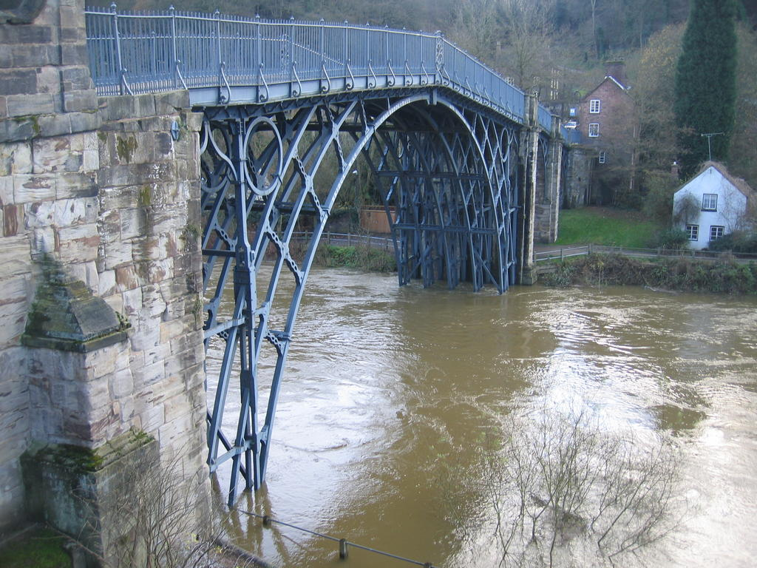
Properties of Materials
Iron-hard gray metallic element, used for making tools or machinery.
Advantages: Molds to any shape, strong in compression.
Disadvantages: Weaker than steel in tension, breaks without warning.

Slide 14
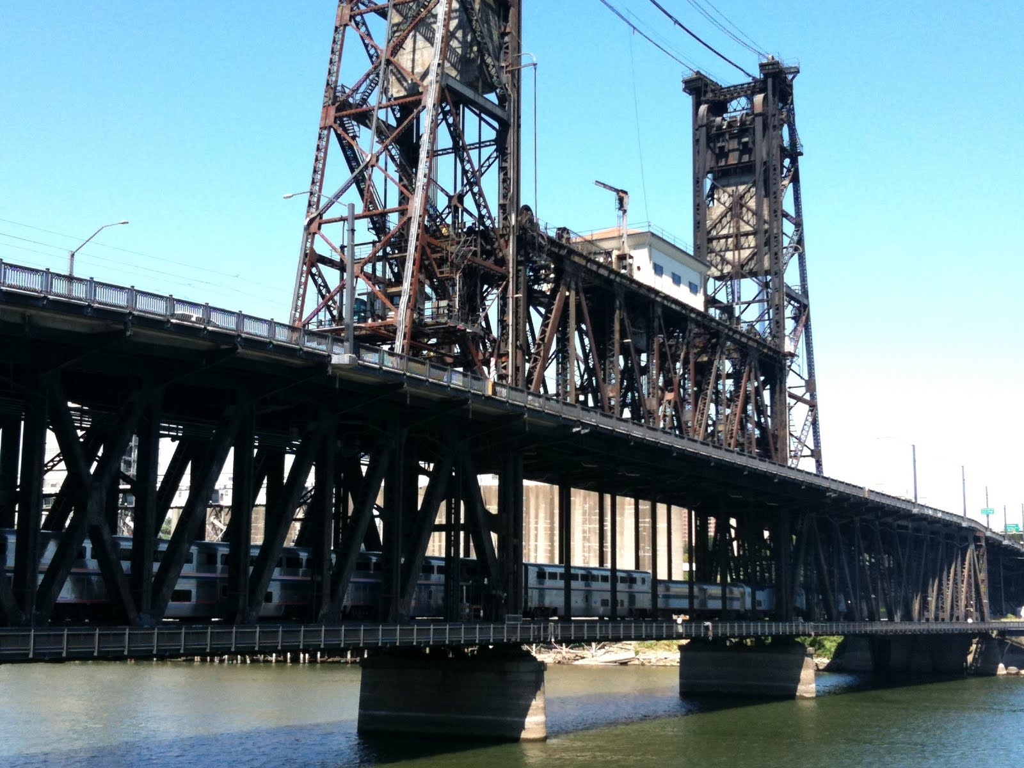
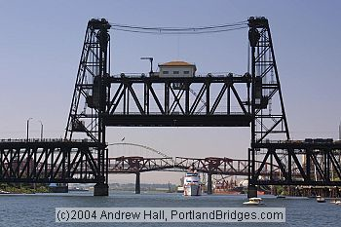
Steel-alloy of iron and carbon.
Advantages: Very strong in compression and tension.
Disadvantages: Rusts, loses strength in extremely high temperatures.

Slide 15
Best Shapes and Structures for Bridges
Rectangles-Weight pushing against the top of a rectangle will cause the sides to bend.
Triangle-Weight pushing at the top will cause the two sides to squeeze together and the bottom side to pull apart. Triangles can handle the most weight and is very sturdy.
Arches- The weight at the top presses down on the arch and the weight is spread outward along the curve of the structure. Still not as stable as the triangle.

